Slide 1
FLYWAY DB

Slide 2

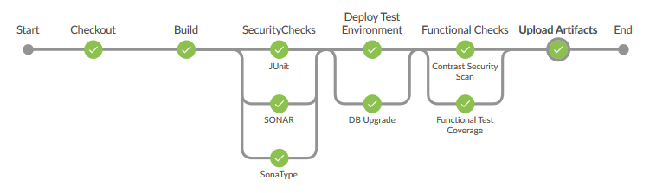
Introduction to JENKINS Build
Jira
Archiva
(3rd. Party dependencies)
Archiva
(upload artifacts)
SVN
Jenkins
Jenkins Build Pipeline

Slide 3


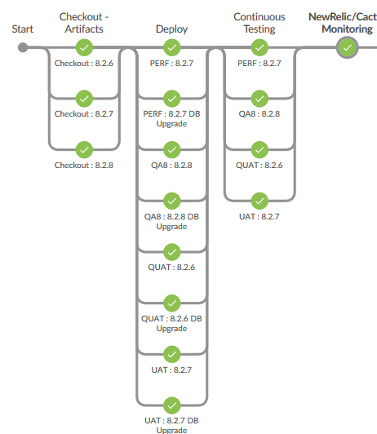
Introduction to JENKINS Deploy
Archiva (Artifacts Checkout)
Approval Request
Jenkins
Static/Dynamic Configuration
Jenkins Prod Deploy Pipeline

Slide 4
Problem Statements
Manually apply the changes to all the environments (QA, UAT, Prod etc.,)
Difficulty to determine
state of database.
Whether scripts success/fail criteria

Slide 5
Flyway DB
Flyway is an open source JAVA based tool developed by BOXFUSE which helps in DB migration
With Flyway changes to the database are called migrations

Slide 6
WHY FLYWAY DB?
Make it clear at all times what state a database is in
Migrate in a deterministic way from your current version of the database to a newer one
Which all the scripts are executed and which are pending
We can always revert to particular stage using flyway

Slide 7
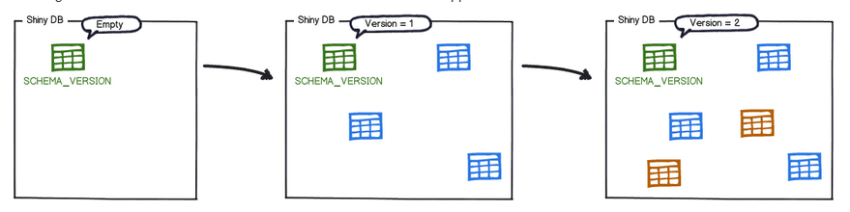
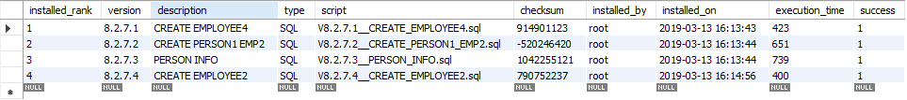
How it works?
Metadata table FLYWAY_SCHEMA_HISTORY
Each change is recorded in metadata table
The migrations are then sorted based on their version number and applied in order

Slide 8
MIGRATION
Versioned migrations have a version, a description and a checksum
The version must be unique. The description is purely informative for you to be able to remember what each migration does. The checksum is there to detect accidental changes.
Undo migrations are the opposite of regular versioned migrations. An undo migration is responsible for undoing the effects of the versioned migration with the same version.
Repeatable migrations have a description and a checksum, but no version. Instead of being run just once, they are (re-)applied every time their checksum changes.

Slide 9

DEV | QA | UAT | PROD
 | Q1(8.2.6) | U1(8.2.5) | SE1(8.2.6)
 |  |  | SE2(8.2.6)
 |  |  | SE3(8.2.6)
DB-TEAM

Slide 10
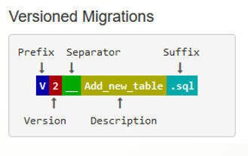
Naming convention for Versioned/Undo migration done Manually
Prefix: V for versioned , U for undo
Version: Version with dots or underscores separate as many parts as you like (Not for repeatable migrations)
Separator: __ (two underscores)
Description: Underscores or spaces separate the words
Suffix: .sql
E.g.: V8.2.7.1__CREATETABLE_SECURITY_LIST.sql

Slide 11
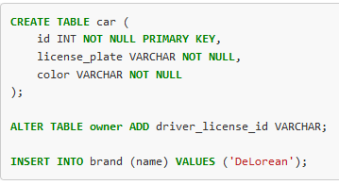
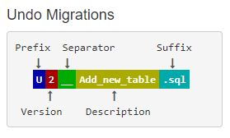
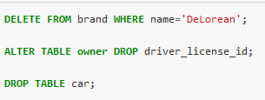
UNDO Migration

Slide 12
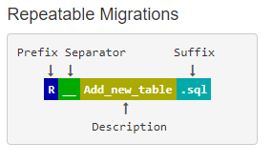
Naming convention for Repeatable migration done Manually
Prefix: V for versioned , U for undo
Separator: __ (two underscores)
Description: Underscores or spaces separate the words
Suffix: .sql

Slide 13
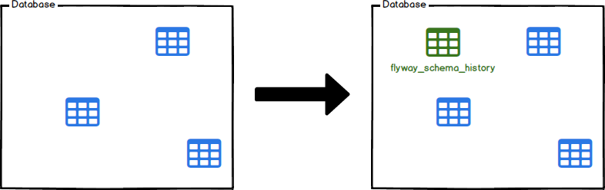
Existing DB baseline
Cmd: flyway -baselineVersion=VERSION baseline

Slide 14
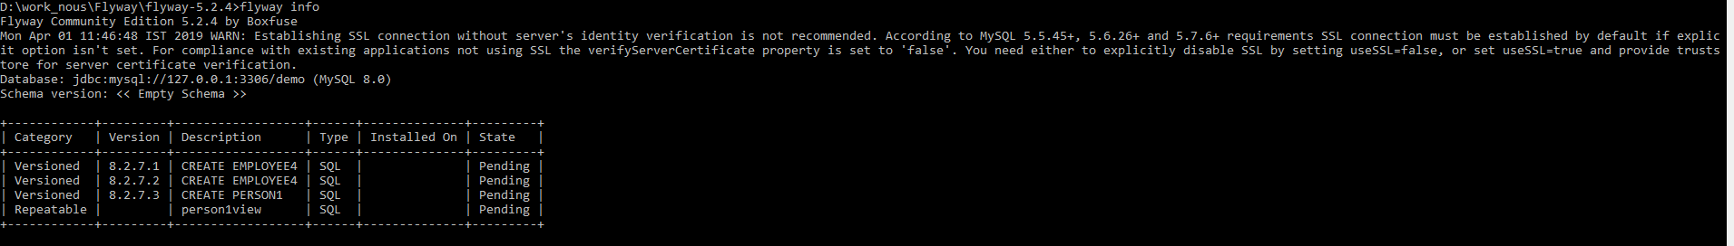
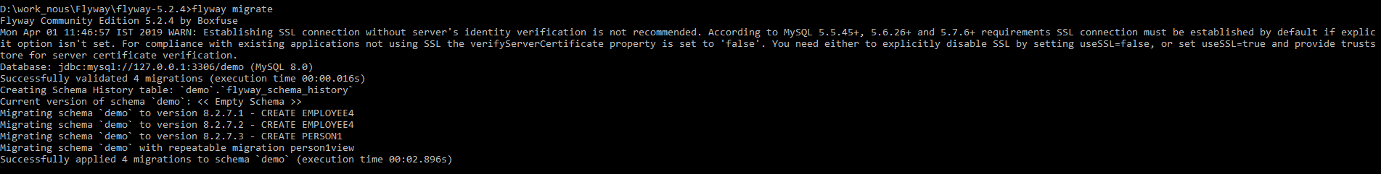
Repeatable Migration

Slide 15
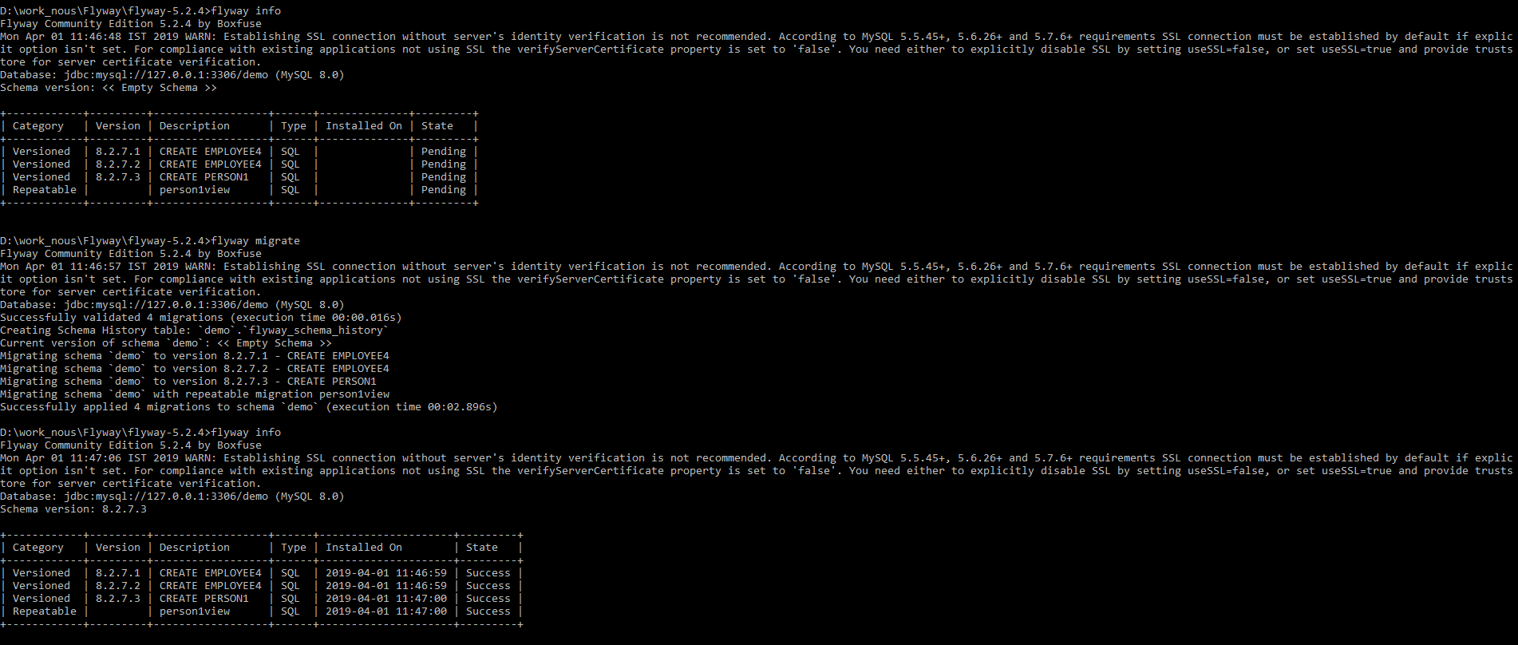
Repeatable Migration

Slide 16
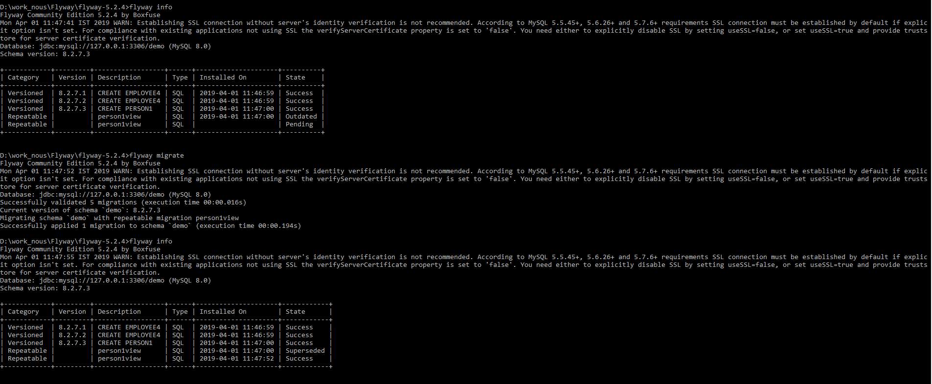

Slide 17
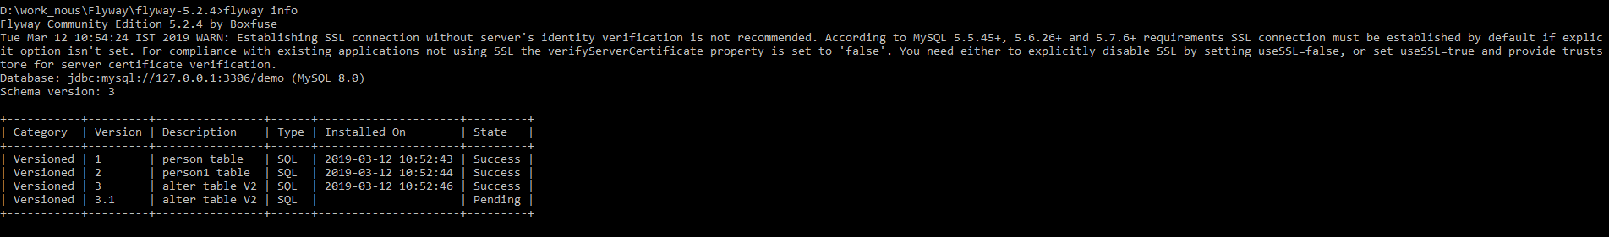
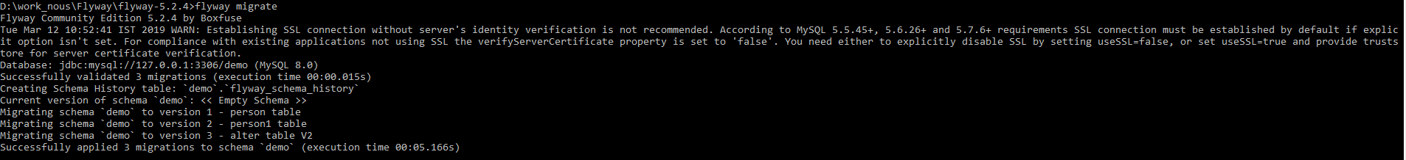
Info,migrate,clean
Info
Migrate
Clean

Slide 18
THANK YOU

